Slide 1
Azure RBAC – Custom Roles
Henry Goodrow
Cloud Solutions Architect (CSA)
hgoodrow@microsoft.com
Twitter - @hgoodrow

Slide 2
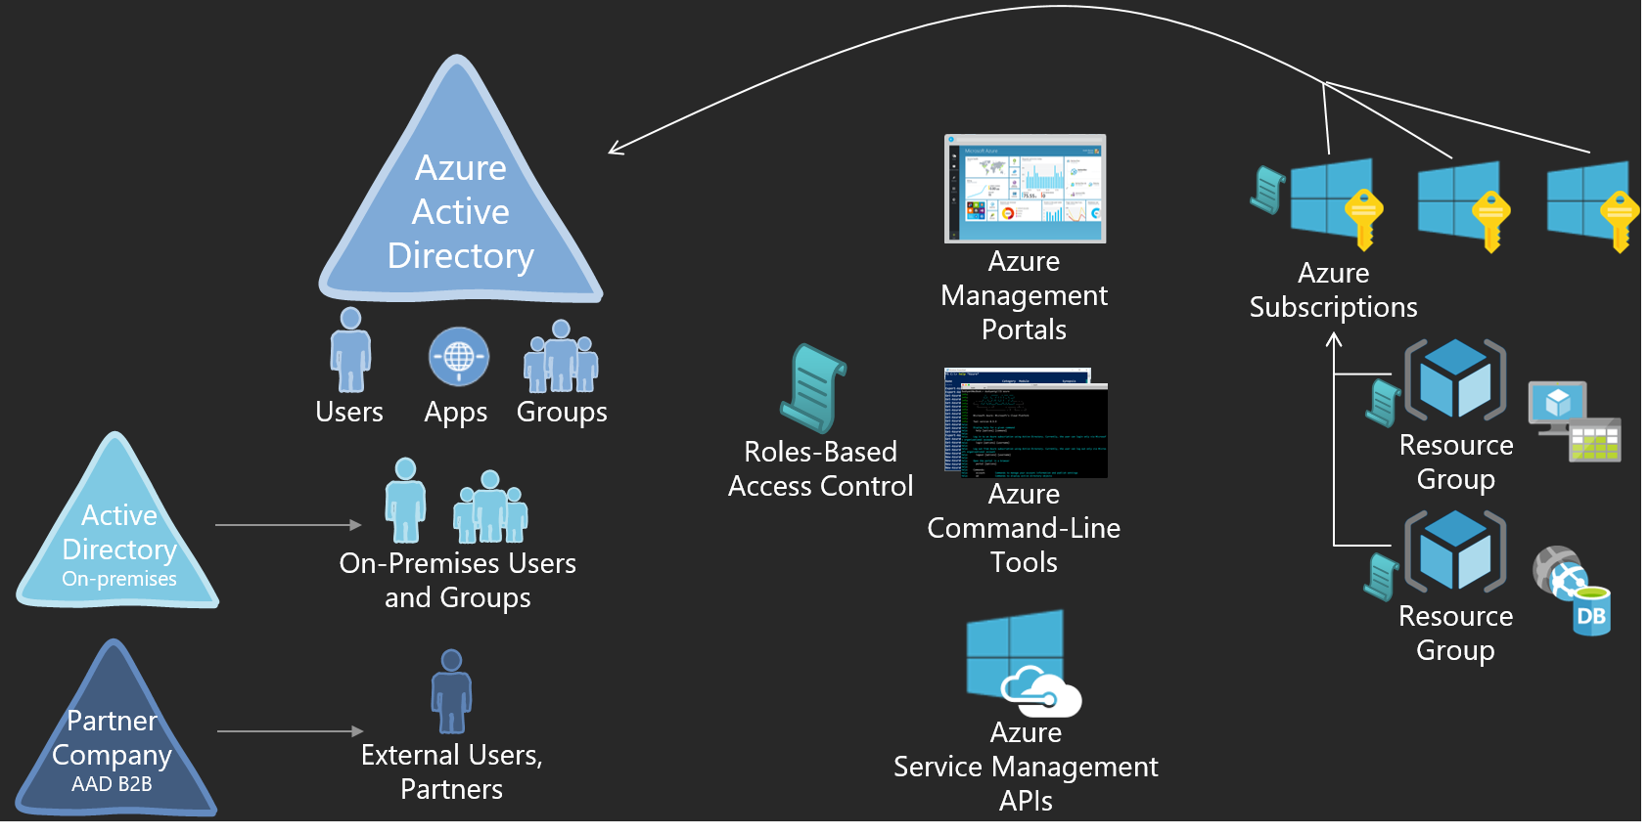
Overview of Access Control in Azure

Slide 3
What roles exist out of the box?
One PowerShell command to output every role:
Get-AzureRmRoleDefinition | ConvertTo-Json | out-file <path\file.json>

Slide 4
Sample: Network Contributor
{
"Name": "Network Contributor",
"Id": "4d97b98b-1d4f-4787-a291-c67834d212e7",
"IsCustom": false,
"Description": "Lets you manage networks, but not access to them.",
"Actions": [
"Microsoft.Authorization/*/read",
"Microsoft.Insights/alertRules/*",
"Microsoft.Network/*",
"Microsoft.Resources/deployments/*",
"Microsoft.Resources/subscriptions/resourceGroups/read",
"Microsoft.Support/*"
],
"NotActions": [
],
"AssignableScopes": [
"/"
]
},

Slide 5
How do I create a custom role?

Slide 6
Actions
The actions property of a custom role specifies the Azure operations to which the role grants access. It is a collection of operation strings that identify securable operations of Azure resource providers. Operation strings that contain wildcards (*) grant access go all operations that match the operation string. For instance:
• */read grants access to read operations for all resource types of all Azure resource providers.
• Microsoft.Network/*/read grants access to read operations for all resource types in the Microsoft.Network resource provider of Azure.
• Microsoft.Compute/virtualMachines/* grants access to all operations of virtual machines and its child resource types.

Slide 7
Not Actions
If the set of operations that you wish to allow is easily expressed by excluding specific operations rather than including all operations except than the ones you wish to exclude, then use the NotActions property of a custom role. The effective access granted by a custom role is computed by excluding the NotActions operations from the Actions operations.
Example:
Actions: */read grants access to read operations for all resource types of all Azure resource providers.
Not Actions: Microsoft.Network/virtualNetworks/read would exclude the ability to read Virtual Networks

Slide 8
Assignable Scopes
The AssignableScopes property of the custom role specifies the scopes (subscriptions, or resource groups, or resources) within which the custom role is available for assignment to users, groups, and applications. Using AssignableScopes you can make the custom role available for assignment in only the subscriptions or resource groups that require it, and not clutter user experience for the rest of the subscriptions or resource groups. AssignableScopes of a custom role also control who is allowed to view, update, and delete the role. Following are some valid assignable scopes:
“/subscriptions/c276fc76-9cd4-44c9-99a7-4fd71546436e”, “/subscriptions/e91d47c4-76f3-4271-a796-21b4ecfe3624”: makes the role available for assignment in two subscriptions.
“/subscriptions/c276fc76-9cd4-44c9-99a7-4fd71546436e”: makes the role available for assignment in a single subscription.
“/subscriptions/c276fc76-9cd4-44c9-99a7-4fd71546436e/resourceGroups/Network”: makes the role available for assignment only in the Network resource group.

Slide 9
Sample: Network Contributor
{
"Name": "Network Contributor",
"Id": "4d97b98b-1d4f-4787-a291-c67834d212e7",
"IsCustom": True,
"Description": "Lets you manage networks, but not access to them.",
"Actions": [
"Microsoft.Authorization/*/read",
"Microsoft.Network/*",
"Microsoft.Support/*"
],
"NotActions": [
],
"AssignableScopes": [
"/"
]
},

Slide 10
Creating and Assigning the Custom Role
Role Definition
New-AzureRmRoleDefinition -InputFile C:\Temp\roleDefinition.json
Role Assignment
New-AzureRmRoleAssignment -ResourceGroupName <rgname> -SignInName <id> -RoleDefinitionName <custom rolename>

Slide 11
Appendix of built-in roles

Slide 12
Classic Network Contributor
{
"Name": "Classic Network Contributor",
"Id": "b34d265f-36f7-4a0d-a4d4-e158ca92e90f",
"IsCustom": false,
"Description": "Lets you manage classic networks, but not access to them.",
"Actions": [
"Microsoft.Authorization/*/read",
"Microsoft.ClassicNetwork/*",
"Microsoft.Insights/alertRules/*",
"Microsoft.Resources/deployments/*",
"Microsoft.Resources/subscriptions/resourceGroups/read",
"Microsoft.Support/*"
],
"NotActions": [
],
"AssignableScopes": [
"/"
]
},

Slide 13
DNS Zone Contributor
{
"Name": "DNS Zone Contributor",
"Id": "befefa01-2a29-4197-83a8-272ff33ce314",
"IsCustom": false,
"Description": "Lets you manage DNS zones and record sets in Azure DNS, but does not let you control who has access to them.",
"Actions": [
"Microsoft.Authorization/*/read",
"Microsoft.Insights/alertRules/*",
"Microsoft.Network/dnsZones/*",
"Microsoft.Resources/deployments/*",
"Microsoft.Resources/subscriptions/resourceGroups/read",
"Microsoft.Support/*"
],
"NotActions": [
],
"AssignableScopes": [
"/"
]
},

Slide 14
Security Manager
{
"Name": "Security Manager",
"Id": "e3d13bf0-dd5a-482e-ba6b-9b8433878d10",
"IsCustom": false,
"Description": "Lets you manage security components, security policies and virtual machines",
"Actions": [
"Microsoft.Authorization/*/read",
"Microsoft.ClassicCompute/*/read",
"Microsoft.ClassicCompute/virtualMachines/*/write",
"Microsoft.ClassicNetwork/*/read",
"Microsoft.Insights/alertRules/*",
"Microsoft.Resources/deployments/*",
"Microsoft.Resources/subscriptions/resourceGroups/read",
"Microsoft.Security/*",
"Microsoft.Support/*"
],
"NotActions": [
],
"AssignableScopes": [
"/"
]
},

